Slide 1

Delayed Freight Predictor
Building predictive intelligence to anticipate and mitigate shipment delays in global logistics operations

Slide 2

CHALLENGE OVERVIEW
The Business Problem
Unpredictable Disruptions
Our logistics operations face chronic delays that impact customer satisfaction and operational costs. With 5,000 historical shipments containing patterns of weather disruptions, port congestion, and route complexities, we need predictive intelligence to anticipate problems before they occur.
Mission: Build a machine learning model that accurately forecasts delay duration, enabling proactive intervention and resource allocation.

Slide 3
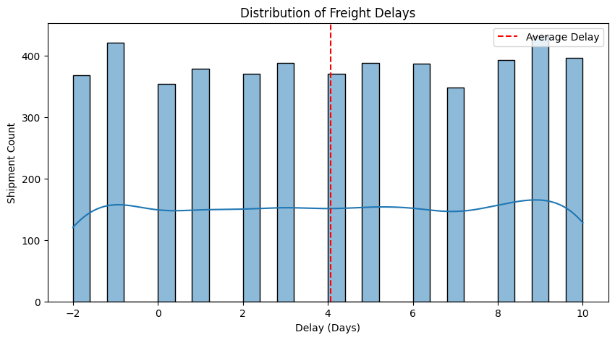
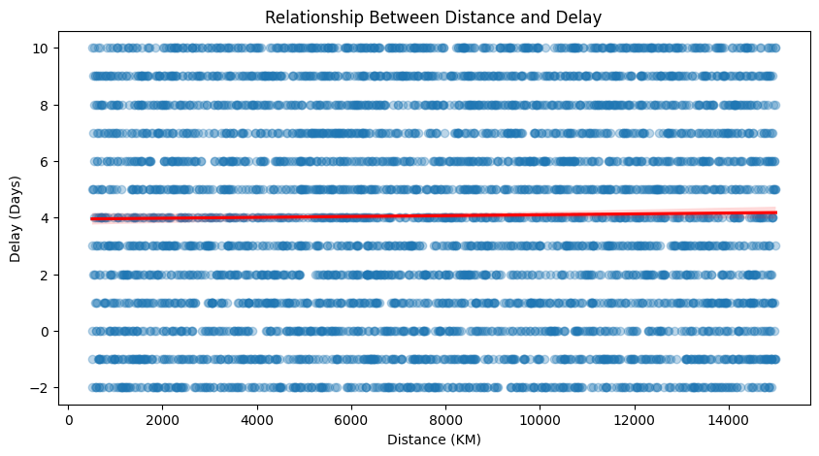
Exploratory Data Analysis (EDA)
Delay Distribution (Histogram with mean line)
Most shipments delayed 0–6 days; average ~4 days, early arrivals rare.
Delay vs Distance (Regplot with trend line)
No meaningful relationship — delays spread evenly (-2 to 10 days) across 0–14,000 km.

Slide 4
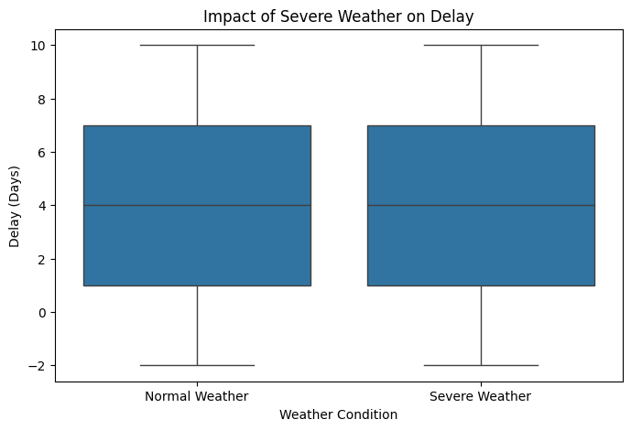
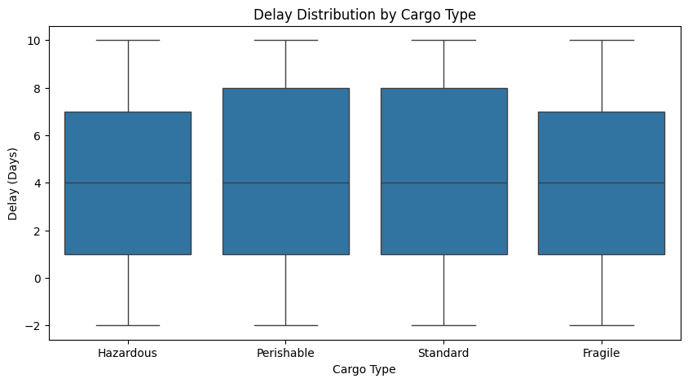
Exploratory Data Analysis (EDA)
Delay by Cargo Type (Boxplot)
Perishable cargo shows highest median delay; Hazardous, Standard, and Fragile are similar.
Impact of Severe Weather (Boxplot)
Severe weather increases median delay by ~1–2 days compared to normal conditions.

Slide 5
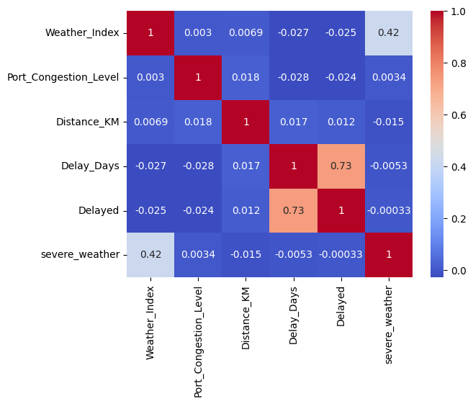
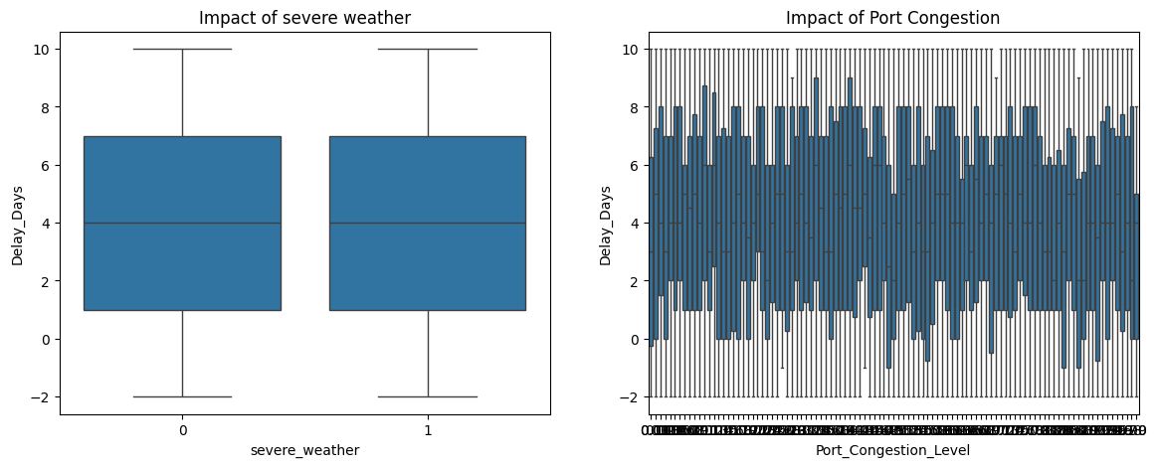
Exploratory Data Analysis (EDA)
Correlation Heatmap
Strong link between Delay Days and Delayed flag (0.73); weather moderate, distance & congestion very weak.
Weather & Congestion Impact (Side-by-side boxplots)
Severe Weather : Median delay is almost the same (~4 days) for normal and severe weather; the two boxes are nearly identical in position, spread, and outliers.
Port Congestion : Delays scatter between 0–10 days across all congestion levels with no visible upward trend or clustering as congestion increases.

Slide 6
Feature Engineering Strategy
Time-Based Features from Planned ETA :
ETA Month → Month of planned arrival (1–12) → Captures seasonal patterns (e.g., monsoon, peak shipping months)
ETA Weekday → Day of week (0=Monday … 6=Sunday)
Weekend → Binary flag (1 = Saturday/Sunday) → Weekend ETAs often face reduced staffing/port activity
Operational & Interaction Features :
Distance per Day = Distance KM / (ETA Month + 1) → Proxy for planned travel speed → avoids division by zero & captures monthly normalization
Congestion Weather = Port Congestion Level × Weather Index → Interaction term → high congestion + bad weather compounds delays non-linearly
Severe weather = 1 if Weather Index > 7 else 0 → Threshold-based flag → focuses model on truly severe conditions (top ~20–30% of index values)
Categorical Binning :
Distance category → Short / Medium / Long (bins: ≤1000 / 1000–10,000 / >10,000 km) → Simplifies long-tail distance effect & helps tree-based models split effectively
Preprocessing Notes :
Missing Carrier Name → filled as 'Unknown'
Missing Port Congestion Level → imputed with median
One-hot encoding applied to categorical columns (Origin Region, Carrier Name, Cargo Type, etc.)

Slide 7
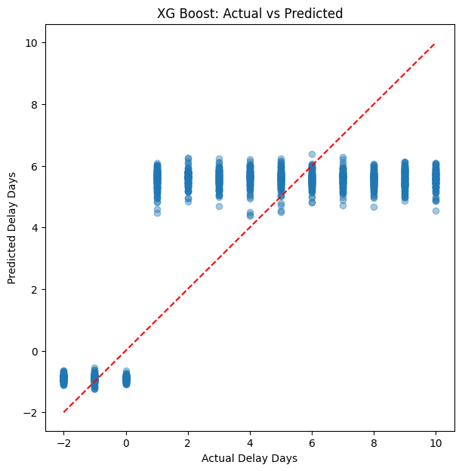
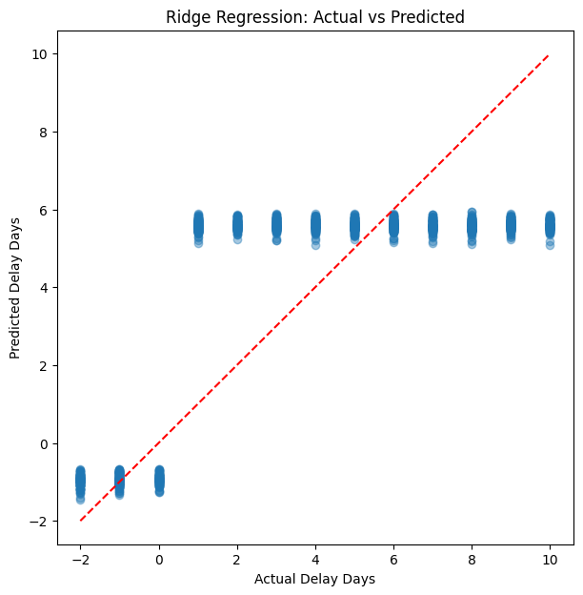
Actual vs Predicted (XG Boost Vs Ridge Regression)
XG Boost predictions align tightly with actuals; Ridge shows more scatter, especially on extremes.

Slide 8
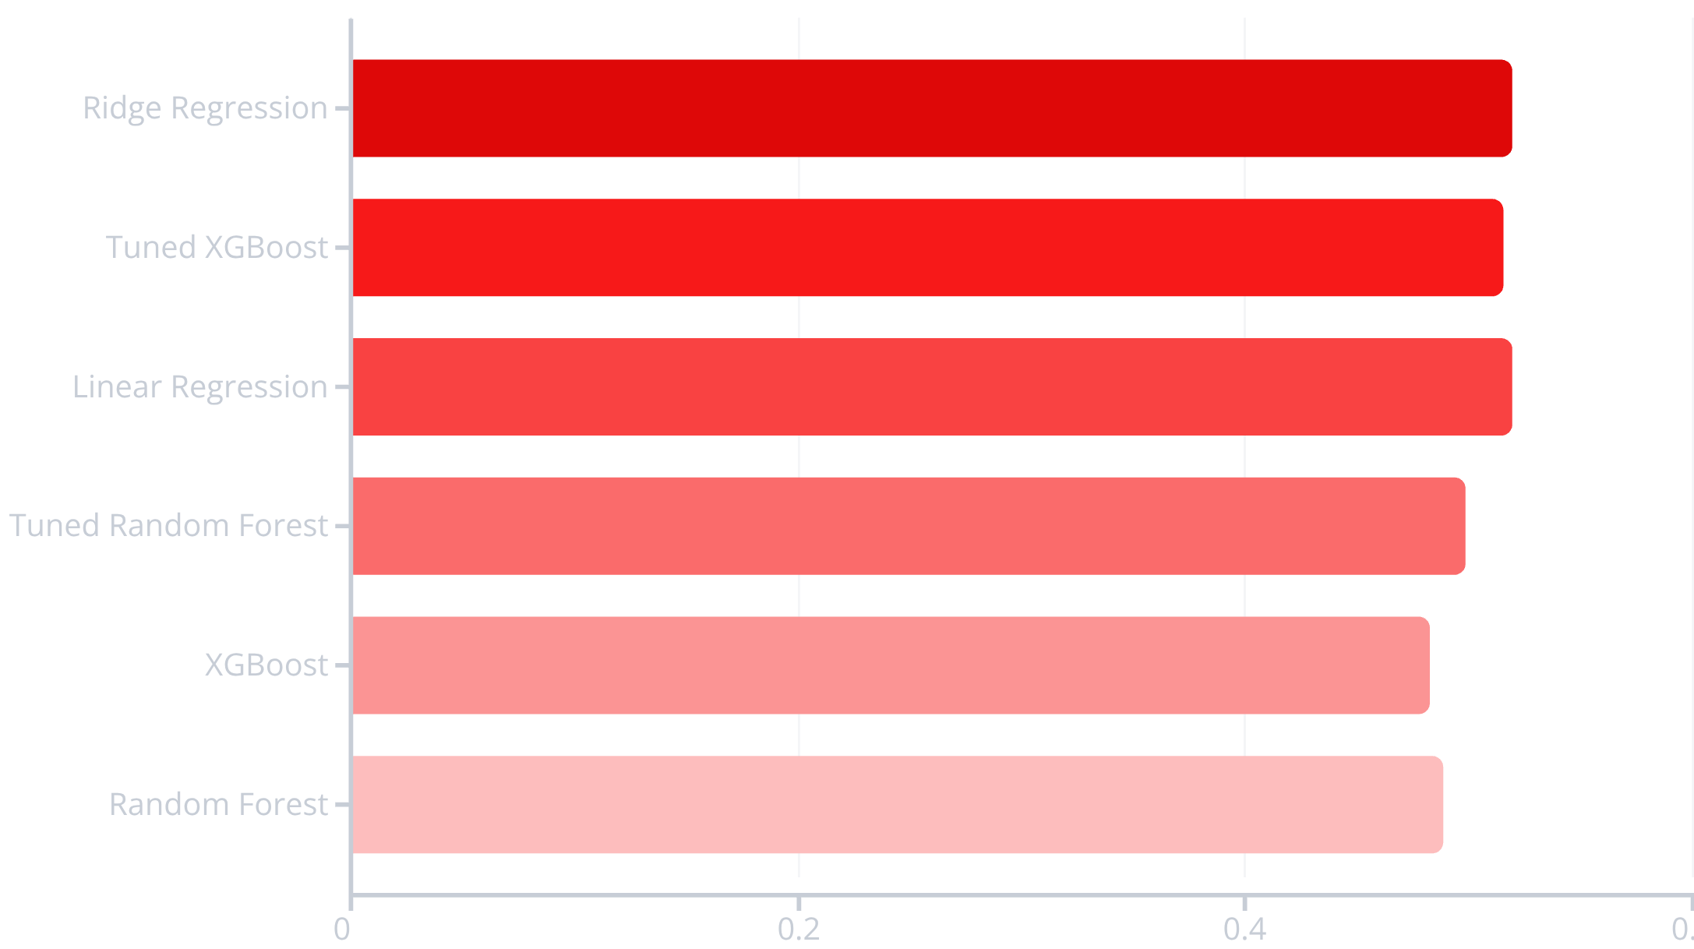
MODEL COMPARISON
Six Algorithms Tested
Performance Summary
Ridge Regression achieved the best R² (0.5194) and lowest MAE (2.12 days), making it the optimal choice for production deployment.
Tuned XGBoost came close at R²=0.516, offering strong performance with interpretability via SHAP values.

Slide 9
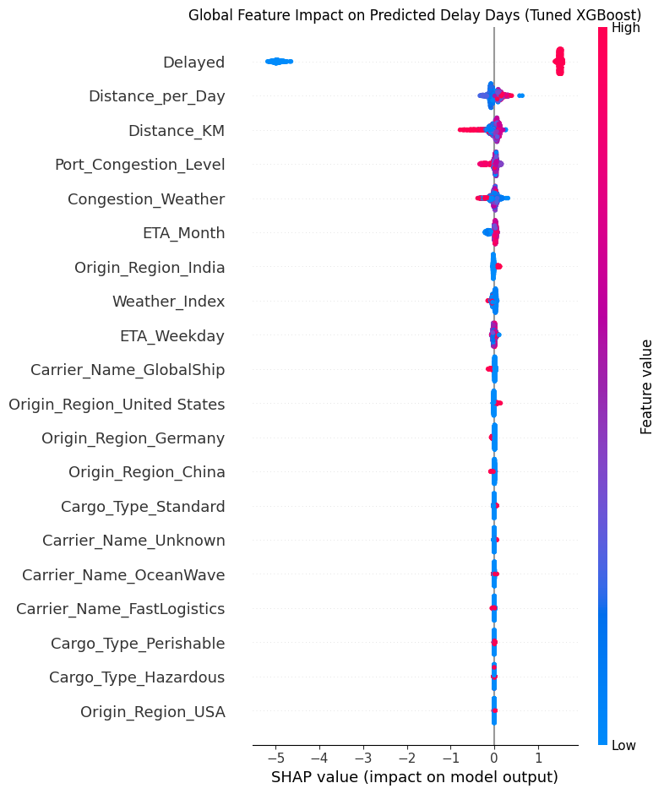
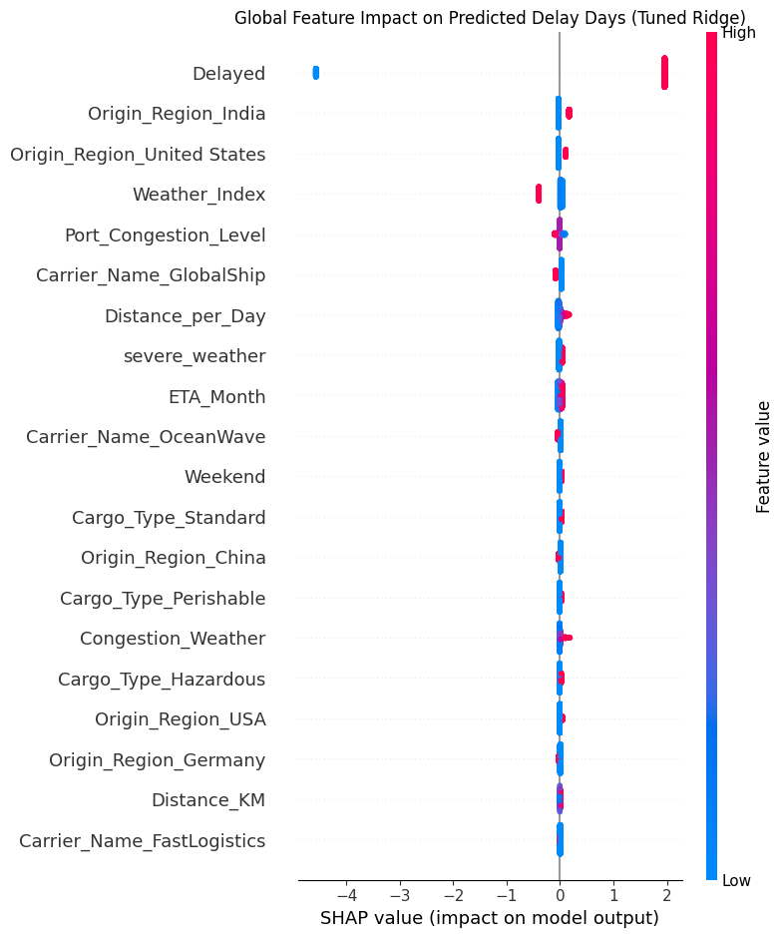
SHAP Summary Plot – Tuned XGBoost vs Random Forest
SHAP confirms: Prioritize bad weather + high congestion + hazardous cargo to reduce delays
Tuned XG Boost
XG Boost identifies complex, non-linear delay drivers, especially weather–congestion interactions, making it ideal for operational risk prediction.
Random Forest :
Ridge provides a stable and interpretable baseline, explaining delays through linear trends rather than complex interactions.

Slide 10
Conclusion & Project Summary
Project Summary :
End-to-end ML solution for predicting freight shipment delays
Raw data (5,000 shipments) → cleaned → engineered features → tuned models
Best model: Ridge Regression (Tuned)
MAE: 2.12 days
R²: 0.519
SHAP explainability: Top drivers = Hazardous Cargo, Weather Index, Port Congestion
Overall, Strengths:
Realistic performance: predicts delays within ±2 days — actionable for logistics
Strong explainability: SHAP shows clear, trustworthy drivers
Practical feature engineering: interaction (Congestion × Weather) & flags boosted results
Business-ready: ties directly to cost savings & customer trust
Business Impact :
Early alerts & rerouting → reduced detention charges (10k–50k/container)
For 1,000 shipments/month → potential savings in lakhs + improved on-time rate
Solves real pain point: unpredictable delays in freight forwarding

Slide 11

Thank You
Thank you for your attention and interest in this Delayed Freight Predictor project. This machine learning solution demonstrates the power of data-driven decision-making in logistics operations. Questions and feedback are welcome. Let's work together to transform freight delay management and create measurable business impact.

